Slide 1

ABBOTT ENSURE
Digital Rapid Read
Digital measurement for media performance and optimisation

Slide 2
We’ve heard about Marketing Mix Modeling. How does it work?
Channel Impact for Sales
 | Sales | Digital Media (Impressions) | No of Distribution Channels | TV GRP
Investment | $2.056 million | 93.27 | 210 | $153,000
Investments & ROI
Attribution to KPI
NOTE : Base is determined by the brand equity.
Modelling Time Period: Jul – Oct 2021
Modelling Time Period: Jul – Oct 2021

Slide 3
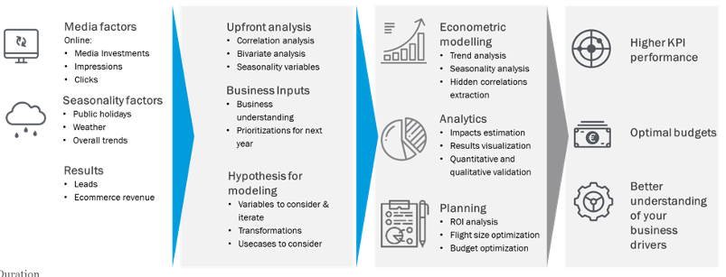
MMMs are made possible through Linear Regression Modelling
What does Linear Regression do?
Determines how much credit is given to each touch or data point leading towards a conversion (i.e. media spends / spreads on Sales)
Predicts conversion outcomes with fixed values for marketing inputs
Data Collection Exploratory Analysis Insights Outcomes

Slide 4
How does Linear Regression work?
“Pushing the needle” – which has a bigger impact?
Remember this formula?
y = mx + c
where
m is gradient of slope
The sharper the gradient, the higher impact on y

Slide 5
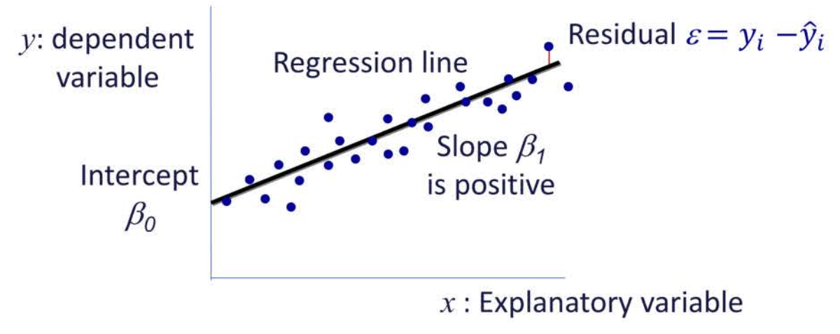
Remember this formula?
y = mx + c
where
m is gradient of slope
The sharper the gradient, the higher impact on y
So the Linear Regression formula is
y_{i} = β₁x_{i} + β₂x_{i+1} + β₃x_{i+2} + β_{i+3} + ε
or
Sales = β₁ (Digital Media) + β₂ (Distribution) + β₃ (TV GRP)
Where value of
β1 = How much Digital Media improves sales
β2 = How much Distribution Channels improve sales
β3 = How much TV GRP improve sales

Slide 6
From this formula, we can attribute various marketing inputs (known as independent variables) to Sales:
Sales = β₁ (Digital Media) + β₂ (Distribution) + β₃ (TV GRP)
Where value of β indicate significance:
β1 = How significant does Digital Media improves sales
β2 = How significant does Distribution Channels improve sales
β3 = How significant does TV GRP improve sales

Slide 7
How do I know if Linear Regression model is accurate?
Due to predictive nature, errors are inherent in every analytics model.
Linear Regression formula is no exception, with ε expressing error value
y_{i} = β₁x_{i} + β₂x_{i+1} + β₃x_{i+2} + β_{i+3} + ε
3 key methods for analysing error in every Linear Regression model
Sum of Squares R²
Significance Testing (p value)
Mean Absolute Percentage Error (MAPE)

Slide 8
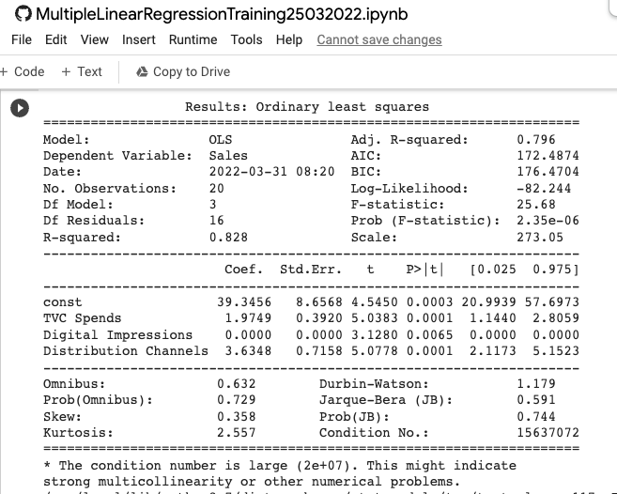
Sum of Squares R₂
The R2 (known as coefficient of determination) measures distance between predictive model and observed values from marketing data. Taking reference from mean of both sets, this is how R2 is calculated:
n
Σ (ŷi - ȳ)² sum of squares from regression (predictive) model
i=1
R2 =
n
Σ (yi - ȳ)² sum of squares from residual (observed) model
i=1
A higher R2 value represents a better model fit, due to variation or correlation between predictive and observed models. In the below example taken from Singapore use case, the R2 (denoted as “R. sq”) tell us which elements (or variables) of digital media budget account for 73% of variation for leads.
R-sqaured or R₂ values are typically displayed in Linear Regression engines

Slide 9
Significance Testing
From the Linear Regression formula, where β indicate significance of each input:
Sales = β₁ (Digital Media) + β₂ (Distribution) + β₃ (TV GRP)
Besides significance, the Linear Regression model would also provide errors (known as P value) for each input
Most Linear Regression engines (such as in Python) provide p values for each input or variable.
p values should be less than 0.1 (0.05 for single tailed) to be considered accurate

Slide 10
Mean Absolute Percentage Error (MAPE)
This is an alternative means of predicting accuracy of regression models. Expressed in % through the following formula:
100% n Actual observed value – Predicted value
MAPE = Σ
n t=1 Actual observed value
MAPE measures the difference between predicted and observed value. So a lower % value for MAPE (less than 5%) would indicate accuracy for predictive model.

